Slide 1
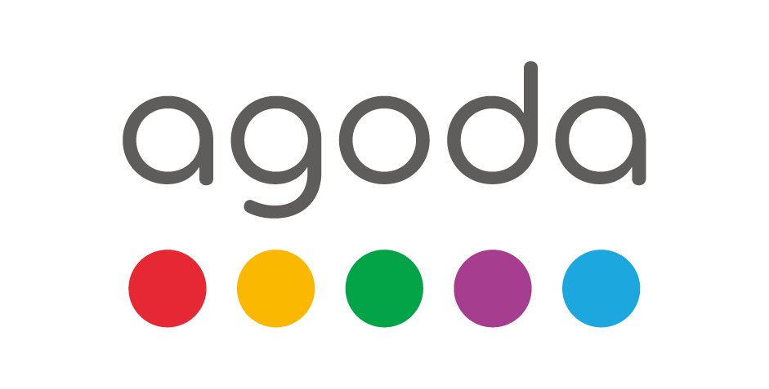

Urgency Message Strategies Case Study
Arunabho Kanti Som
Notes:
To change the image on this slide, select the picture and delete it. Then click the Pictures icon in the placeholder to insert your own image.

Slide 2
Agenda
Task:
Launch of Urgency Message Feature
Goal:
Driving Bookings Through Effective Messaging
Analysis:
Insights from Data, Price Trends & User Behavior
Strategy:
Optimizing Conversion, Placement & Timing of Urgency Messages
Unveiling the new feature designed to accelerate the booking process and enhance user engagement
Targeting increased conversion rates by leveraging psychological triggers in message framing.
Deep dive into data revealing how price fluctuations and booking timelines influence user decisions.
Strategic deployment of messages throughout the user journey, backed data analytics.

Slide 3
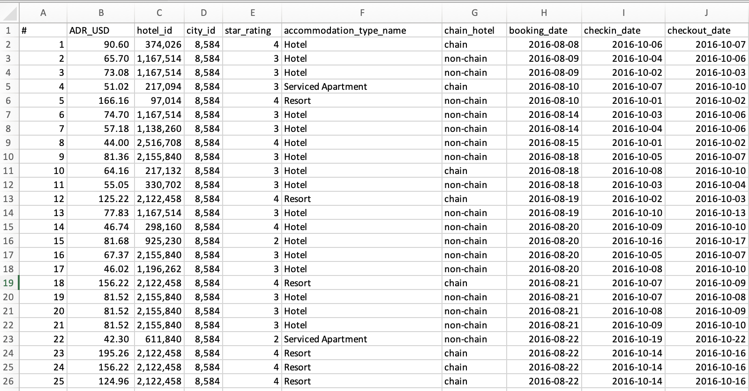
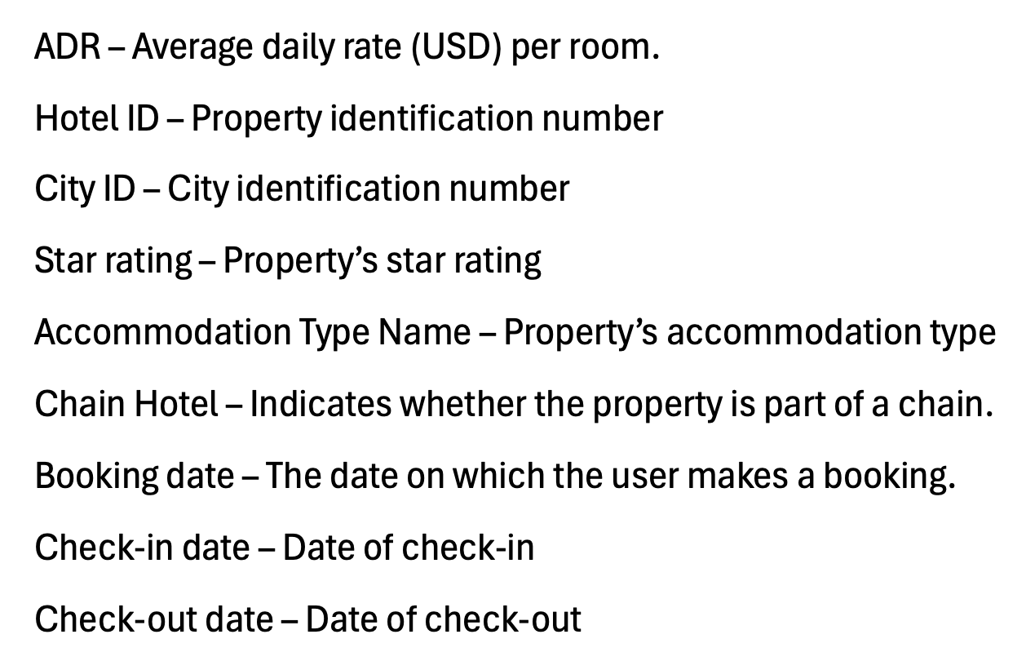
Data Overview
Dataset
Data Dictionary

Slide 4
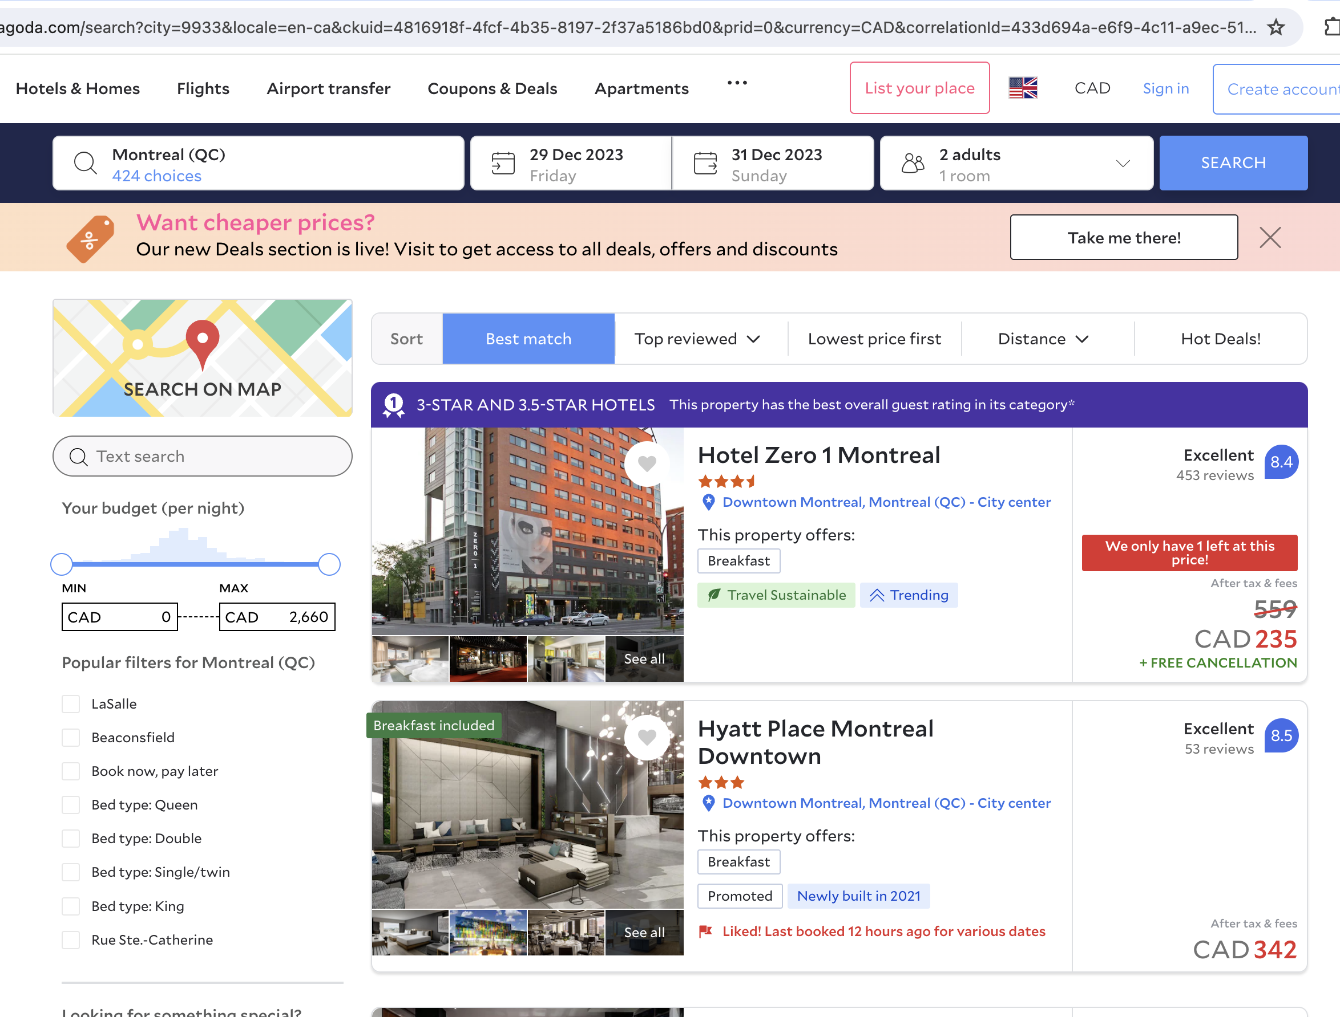
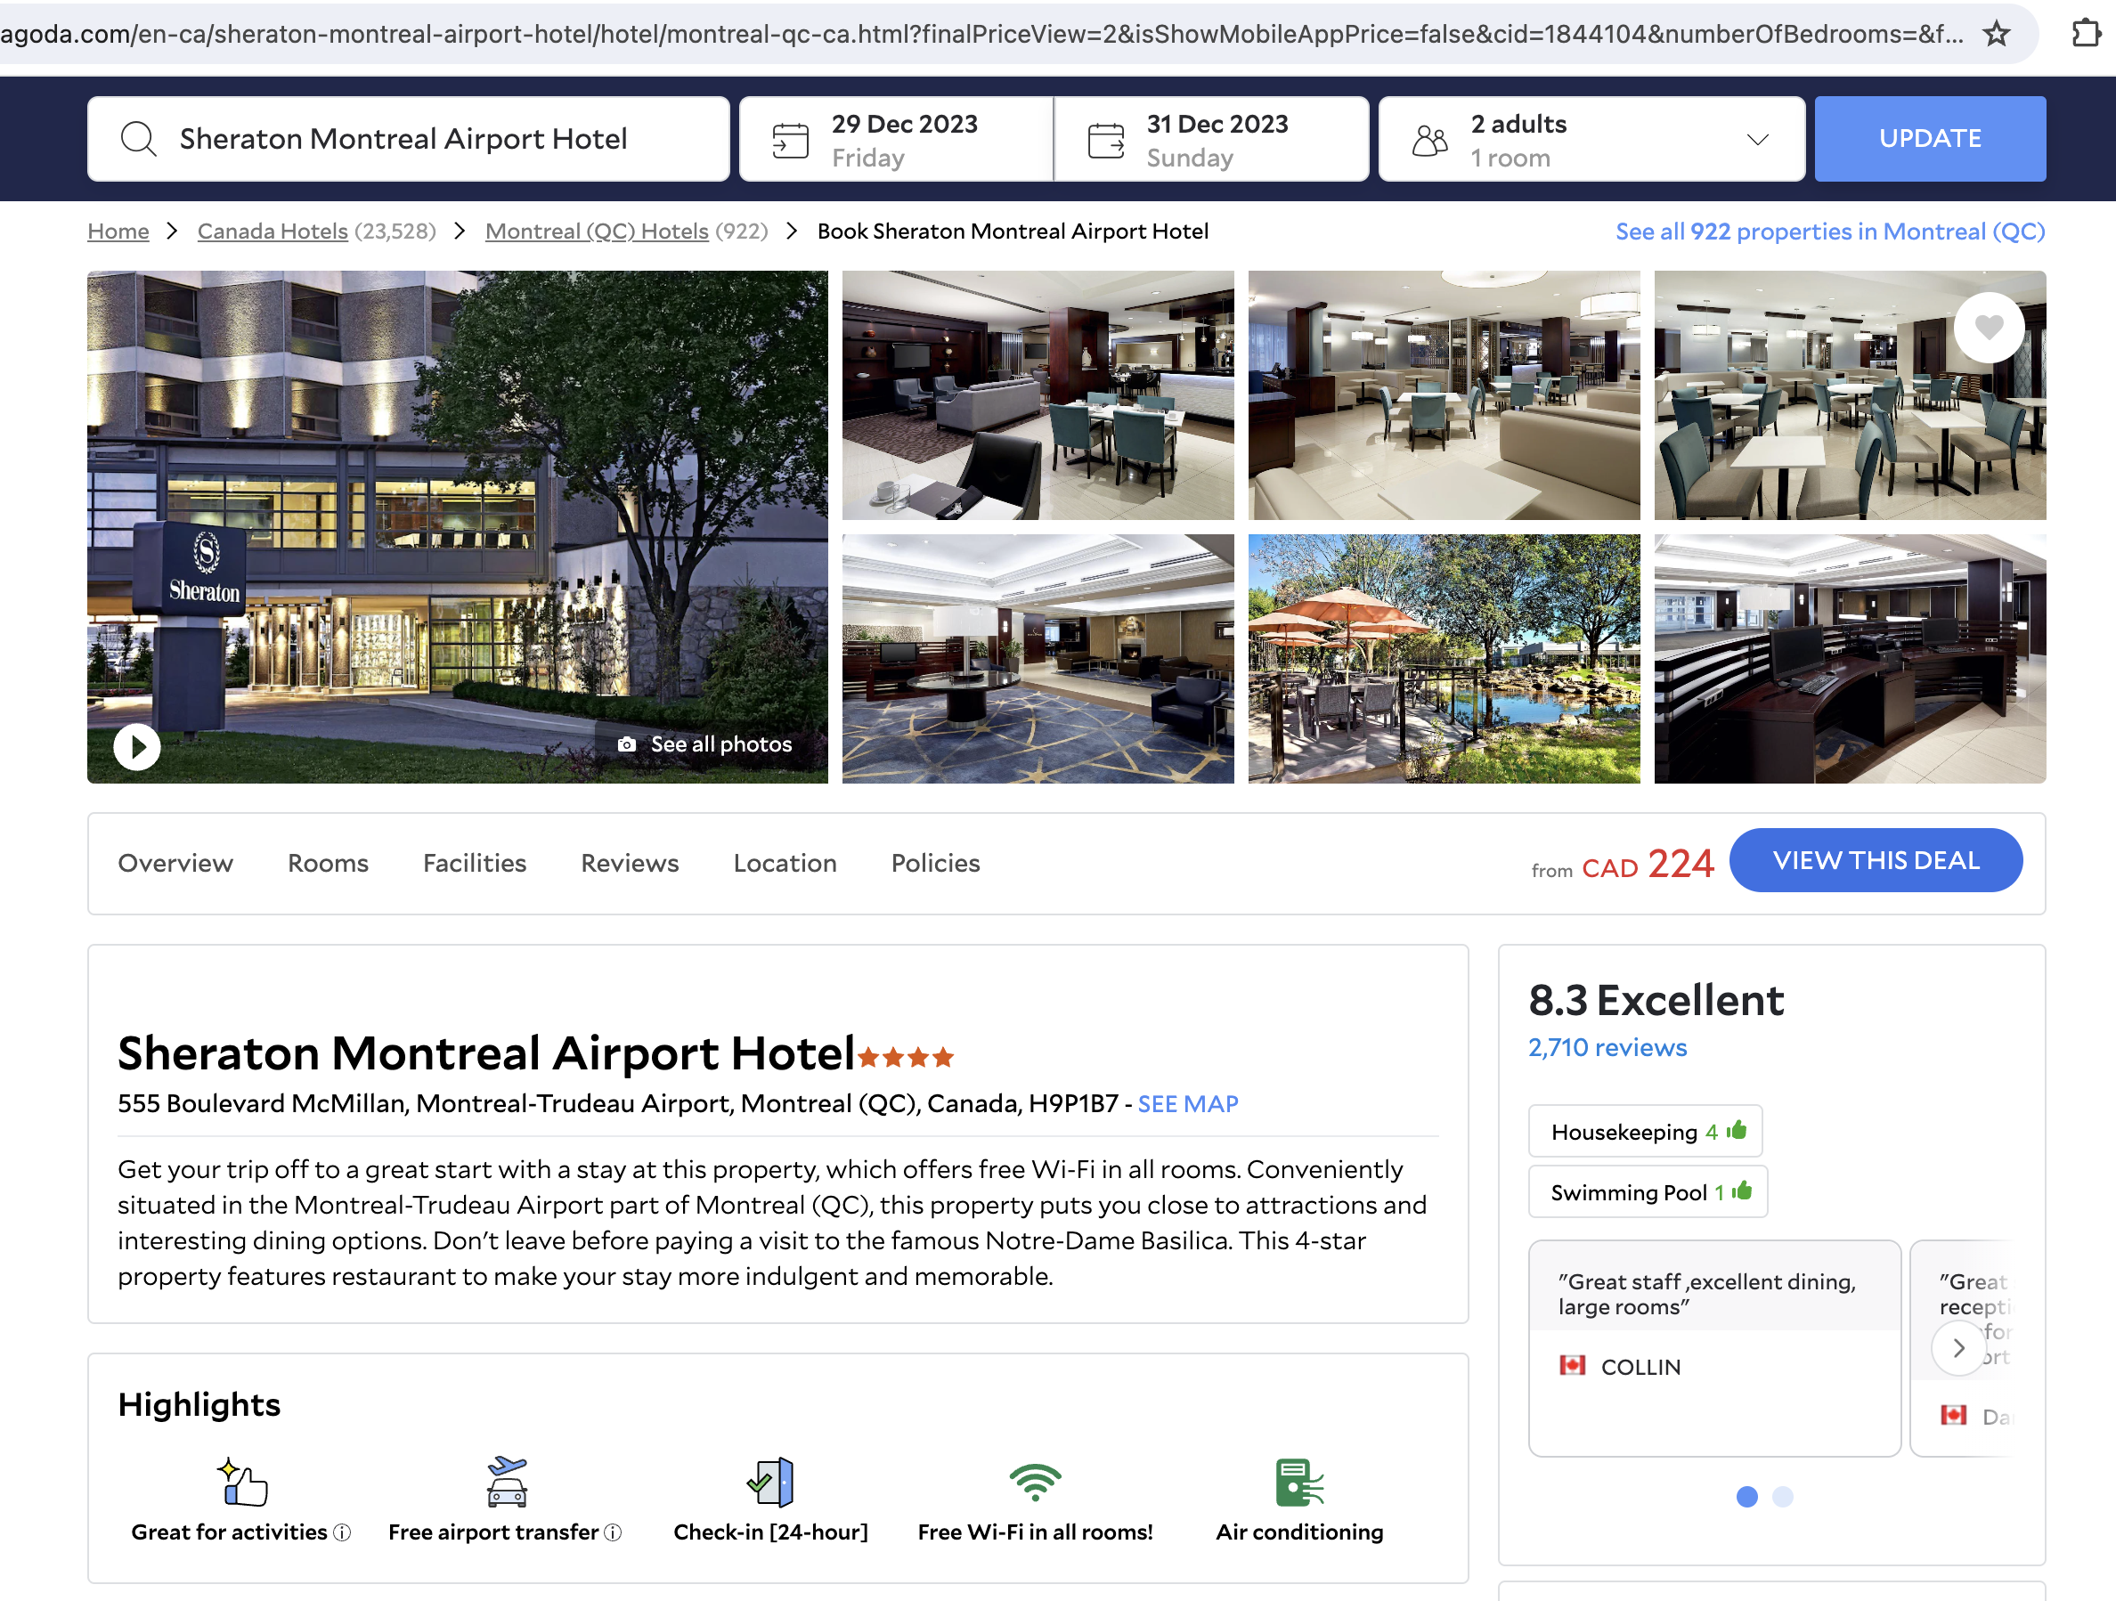
Agoda Website Structure
Search Result Page
Property page

Slide 5
Case Study Parameters
ADR
ADR by Lead Time: Pricing dynamics from booking to stay.
ADR by Accommodation Type : Revenue trends across property types.
ADR by Star Rating: Earnings correlated with hotel ratings.
ADR by Number of Bookings: Pricing by total reservation counts assessed.
ADR by Chain/ Non- chain: Revenue comparison: chain versus independent.
Number of Bookings
Bookings by Accommodation Type: Booking frequency per property type.
Bookings by Lead Time: Booking timelines to check-in analyzed.
Bookings by City: Location-based booking volumes.
Bookings by Duration of Stay: Number of bookings by one-day or multiple stay.
Bookings by Chain/ Non- chain: Chain versus independent booking rates.

Slide 6
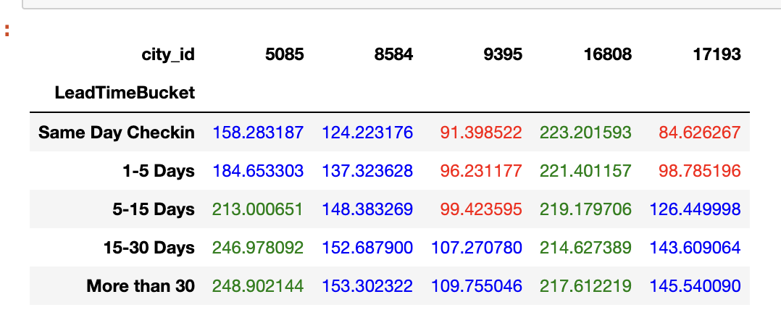
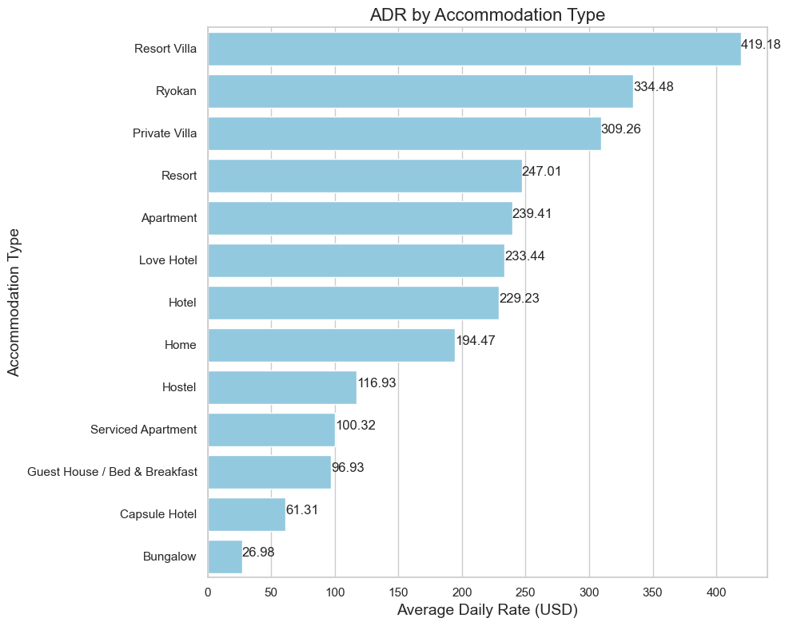
EDA: Impact on ADR
ADR Variation by Booking Lead Time:
The image displays a table comparing average daily rates (ADR) across different city IDs for varying lead times. Lead time is categorized into several buckets: Same Day Check-in, 1-5 Days, 5-15 Days, 15-30 Days, and More than 30 Days.
Comparative ADR Across Accommodation Types:
We can see the average daily rates (ADR) based on the accommodation type, which would help us understand the price distribution.

Slide 7
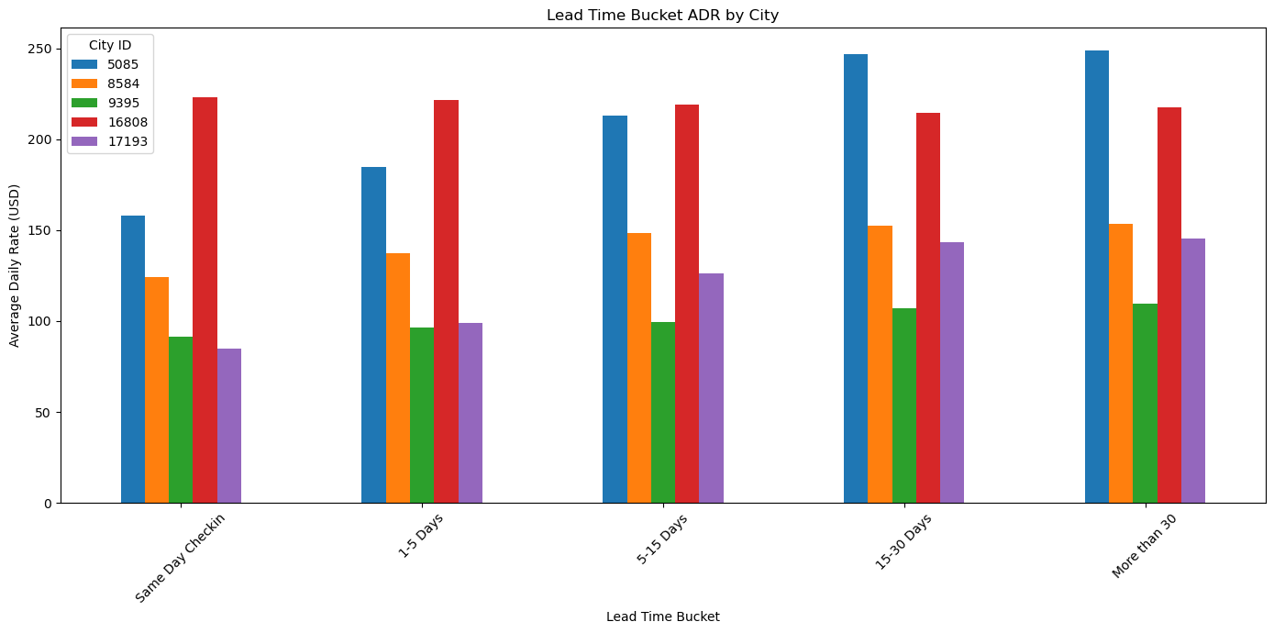
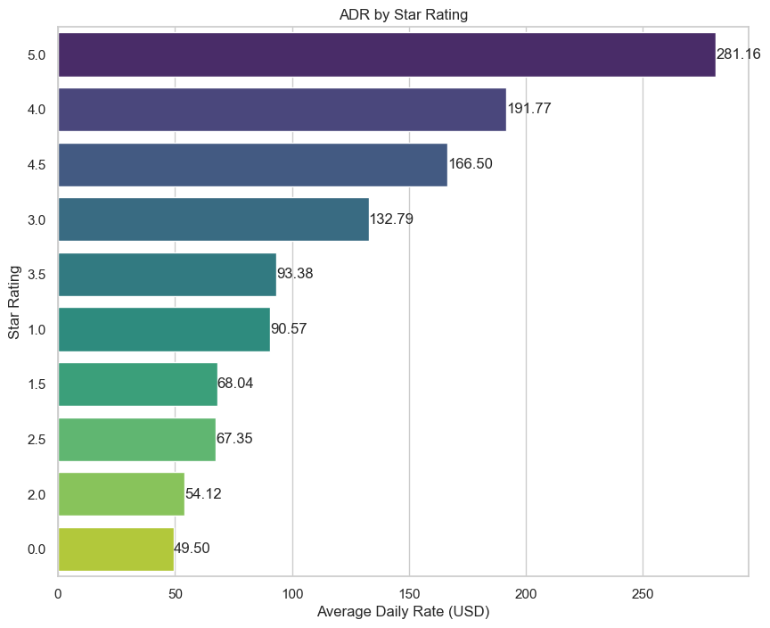
EDA: Impact on ADR Contd.
ADR Premiums by Star Ratings:
We can see the average ADR based on the accommodation type, which would help us the price distribution.
ADR over Lead Time by City:
Fluctuations in ADR by city may indicate optimal timing for urgency messages based on Last minute booking premiums.

Slide 8
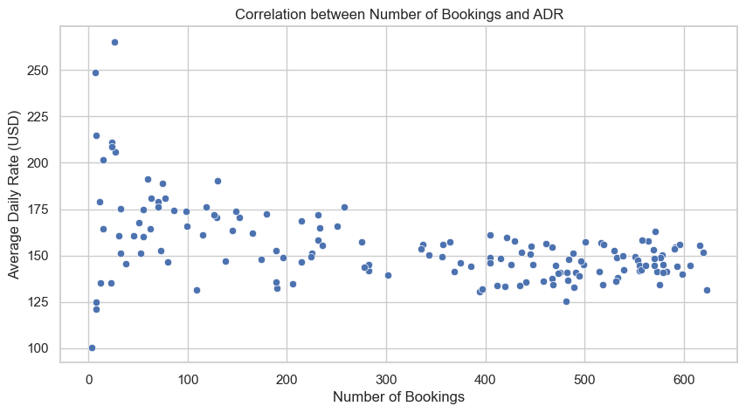
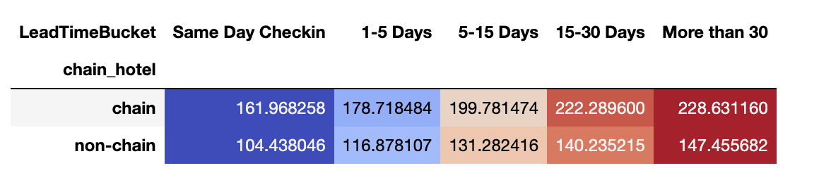
EDA: Impact on ADR Contd.
Correlation between Booking number and ADR:
The scatter plot doesn't indicate a strong linear. The lack of a strong correlation suggests that pricing strategies may be complex and influenced by multiple factors beyond just the number of bookings.
ADR by Chain or Non-Chain accommodations:
The image represents the Average Daily Rate (ADR) based on the lead time for booking and the type of hotel (chain vs. non-chain). Higher ADR for chain hotels across all lead times may indicate brand value's impact on pricing.

Slide 9
Strategy Based on ADR insight:
Identifying Peak Pricing Periods: The clear peaks in ADR are high-demand periods, ideal for implementing urgency messages like "Limited availability during peak season!" or "Prices expected to rise – book now!" to encourage immediate bookings.
Recognizing Off-Peak Opportunities: The lower ADR periods suggest demand is lower. Marketing campaigns can target these with deals to stimulate demand, such as "Best Price Guarantee" or "Exclusive off-season deals available now!"
Differentiation by Accommodation Type: The varying ADRs across accommodation types point to different market segments with distinct behaviors. Luxury accommodations see higher ADRs suggesting less price-sensitive customers highlighting exclusivity. For more budget-conscious travelers, promotions could emphasize value for money.
Short-term vs. Long-term Lead Times: For last-minute bookings leading to higher ADRs, urgency tactics like "Last chance to get a room!" could be effective. Conversely, if there's a benefit in early bookings, messages like "Early bird discounts for proactive planners!" could be used.

Slide 10
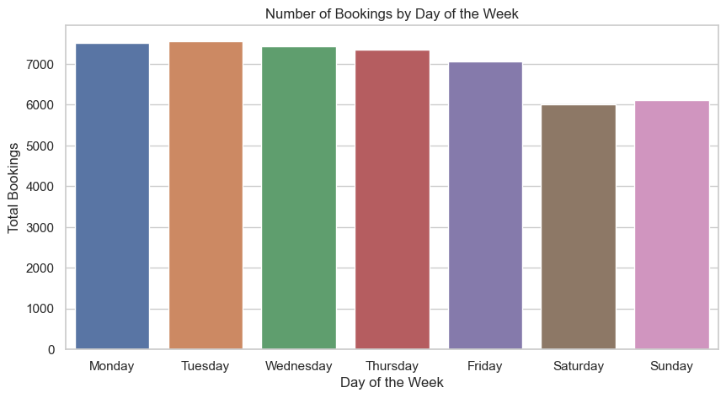
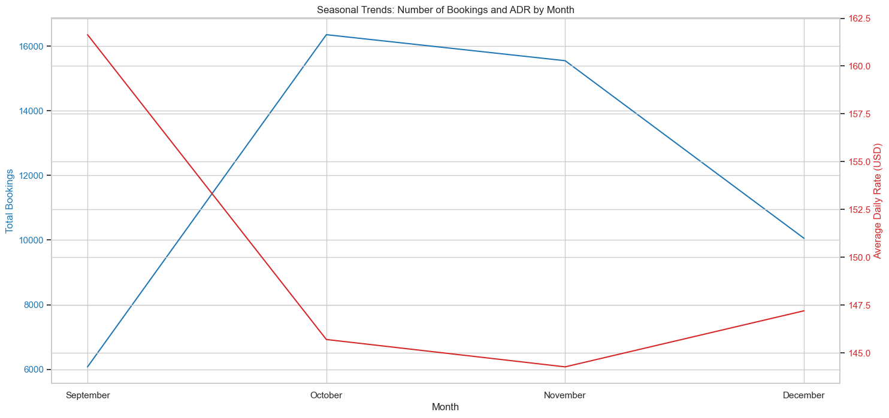
EDA: Impact on Number of Bookings
Number of Booking vs Days of Week:
Data shows weekends saw lesser number bookings compared to the weekdays. Weekday booking stability offers targeted opportunity for mid-week urgency promotions to boost weekend demand.
Number of Bookings and ADR by month:
The is a line chart that shows the seasonal trends of the number of bookings and Average Daily Rate (ADR) by month. Inverse seasonal booking and ADR trends call for dynamic pricing strategies to maximize revenue during off-peak periods.

Slide 11
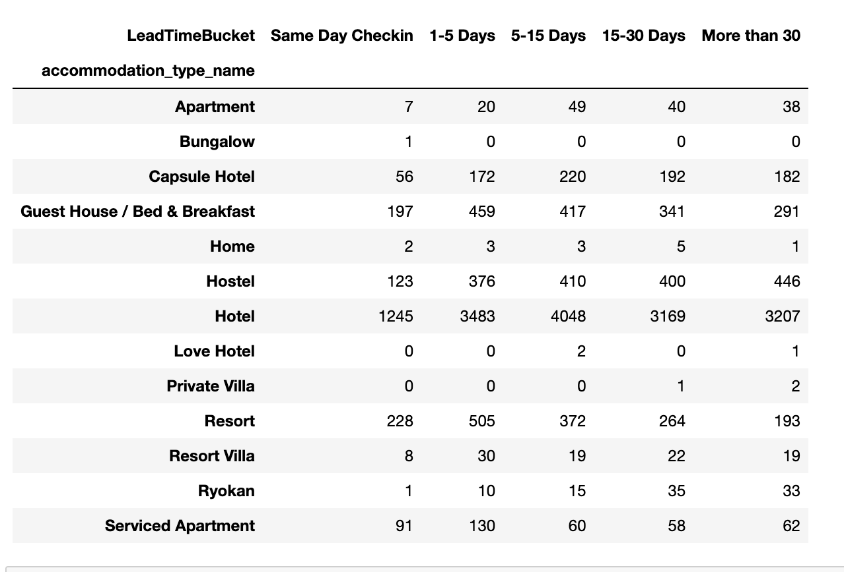
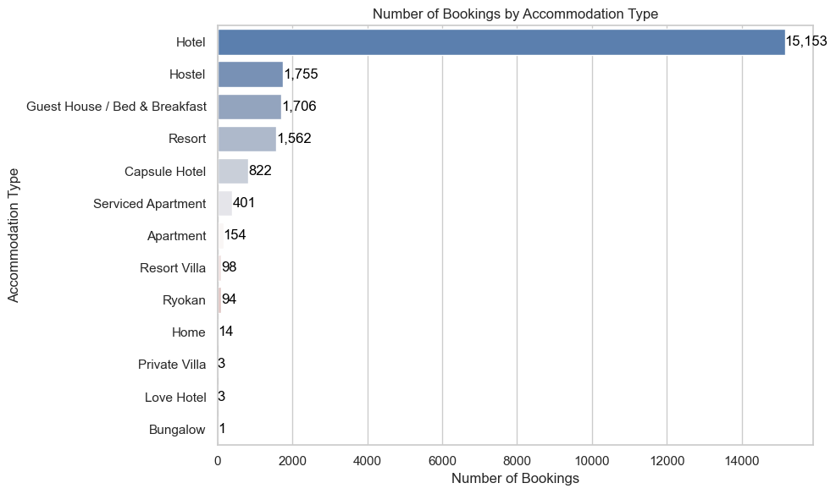
EDA: Impact on Number of Bookings Contd.
Booking number and Accommodation type by Lead time:
Diverse booking lead times across accommodation types highlight opportunities for tailored urgency messaging, with hotels showing a consistently high booking volume.
Number of Bookings by Accommodation Type:
The image provided is a bar chart showing the number of bookings by accommodation type. The dominance of hotels in booking volume underscores the need for targeted urgency campaigns, especially for non-hotel accommodations to boost their competitive edge..

Slide 12
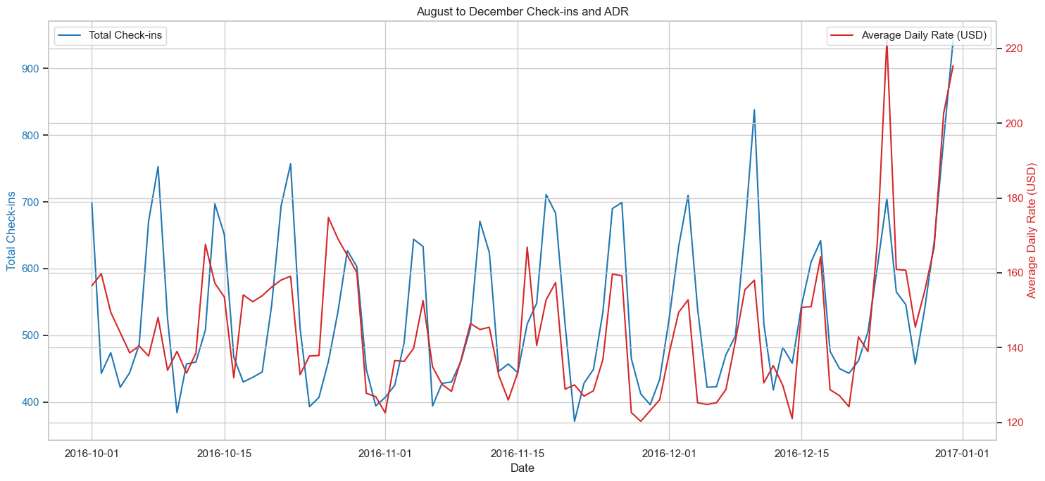
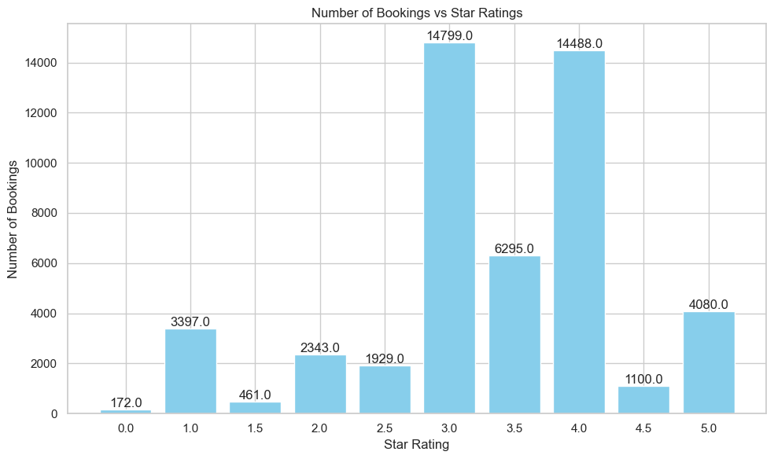
Impact on Number of Bookings Contd.
Number of Bookings by ADR over Month of Check-In:
The image is a line graph is tracking two different variables over time:
Total Check-ins (represented by the blue line) and Average Daily Rate (ADR) in USD (represented by the red line).
Number of Bookings by Star rating
The line chart shows the number of bookings by star rating. Higher number of booking would indicate the price sensitivity of the customer.

Slide 13
Strategy insight Based on Number of Booking:
Weekdays vs Weekends: The lower number of bookings on weekends suggests an opportunity to increase demand during these days by creating a sense of value and urgency specific to weekends when customers may be more likely to consider short trips or spontaneous travel. Ex: Boost Your Weekend Getaway - Book Now and Save!"
Seasonal Pricing: The inverse relationship between bookings and ADR suggests that customers are sensitive to price changes and may book more when rates are lower. The strategy leverages the high ADR when demand is at its peak, by offering customers a chance to book at the lower rates, creating a compelling reason to book immediately. Ex: "Seasonal Surge Special: Secure Your December Stay at November Rates!"
Early Bird Discounts: Early bookings (especially in the 1-30 day range) seem popular among guests, indicating that customers are planning ahead but not too far in advance. This can be an opportunity to create urgency by offering special benefits for early bookings to incentivize even earlier reservations. Ex: “Early Bird: Unlock Exclusive Benefits!”
Booking Exclusivity: Emphasize the value and quality of these popular choices in urgency messages to attract guests looking for the best balance of comfort and cost. Ex: "Guest Favorite: Book Your Ideal Stay in Our Top-Rated Hotels Now!”

Slide 14
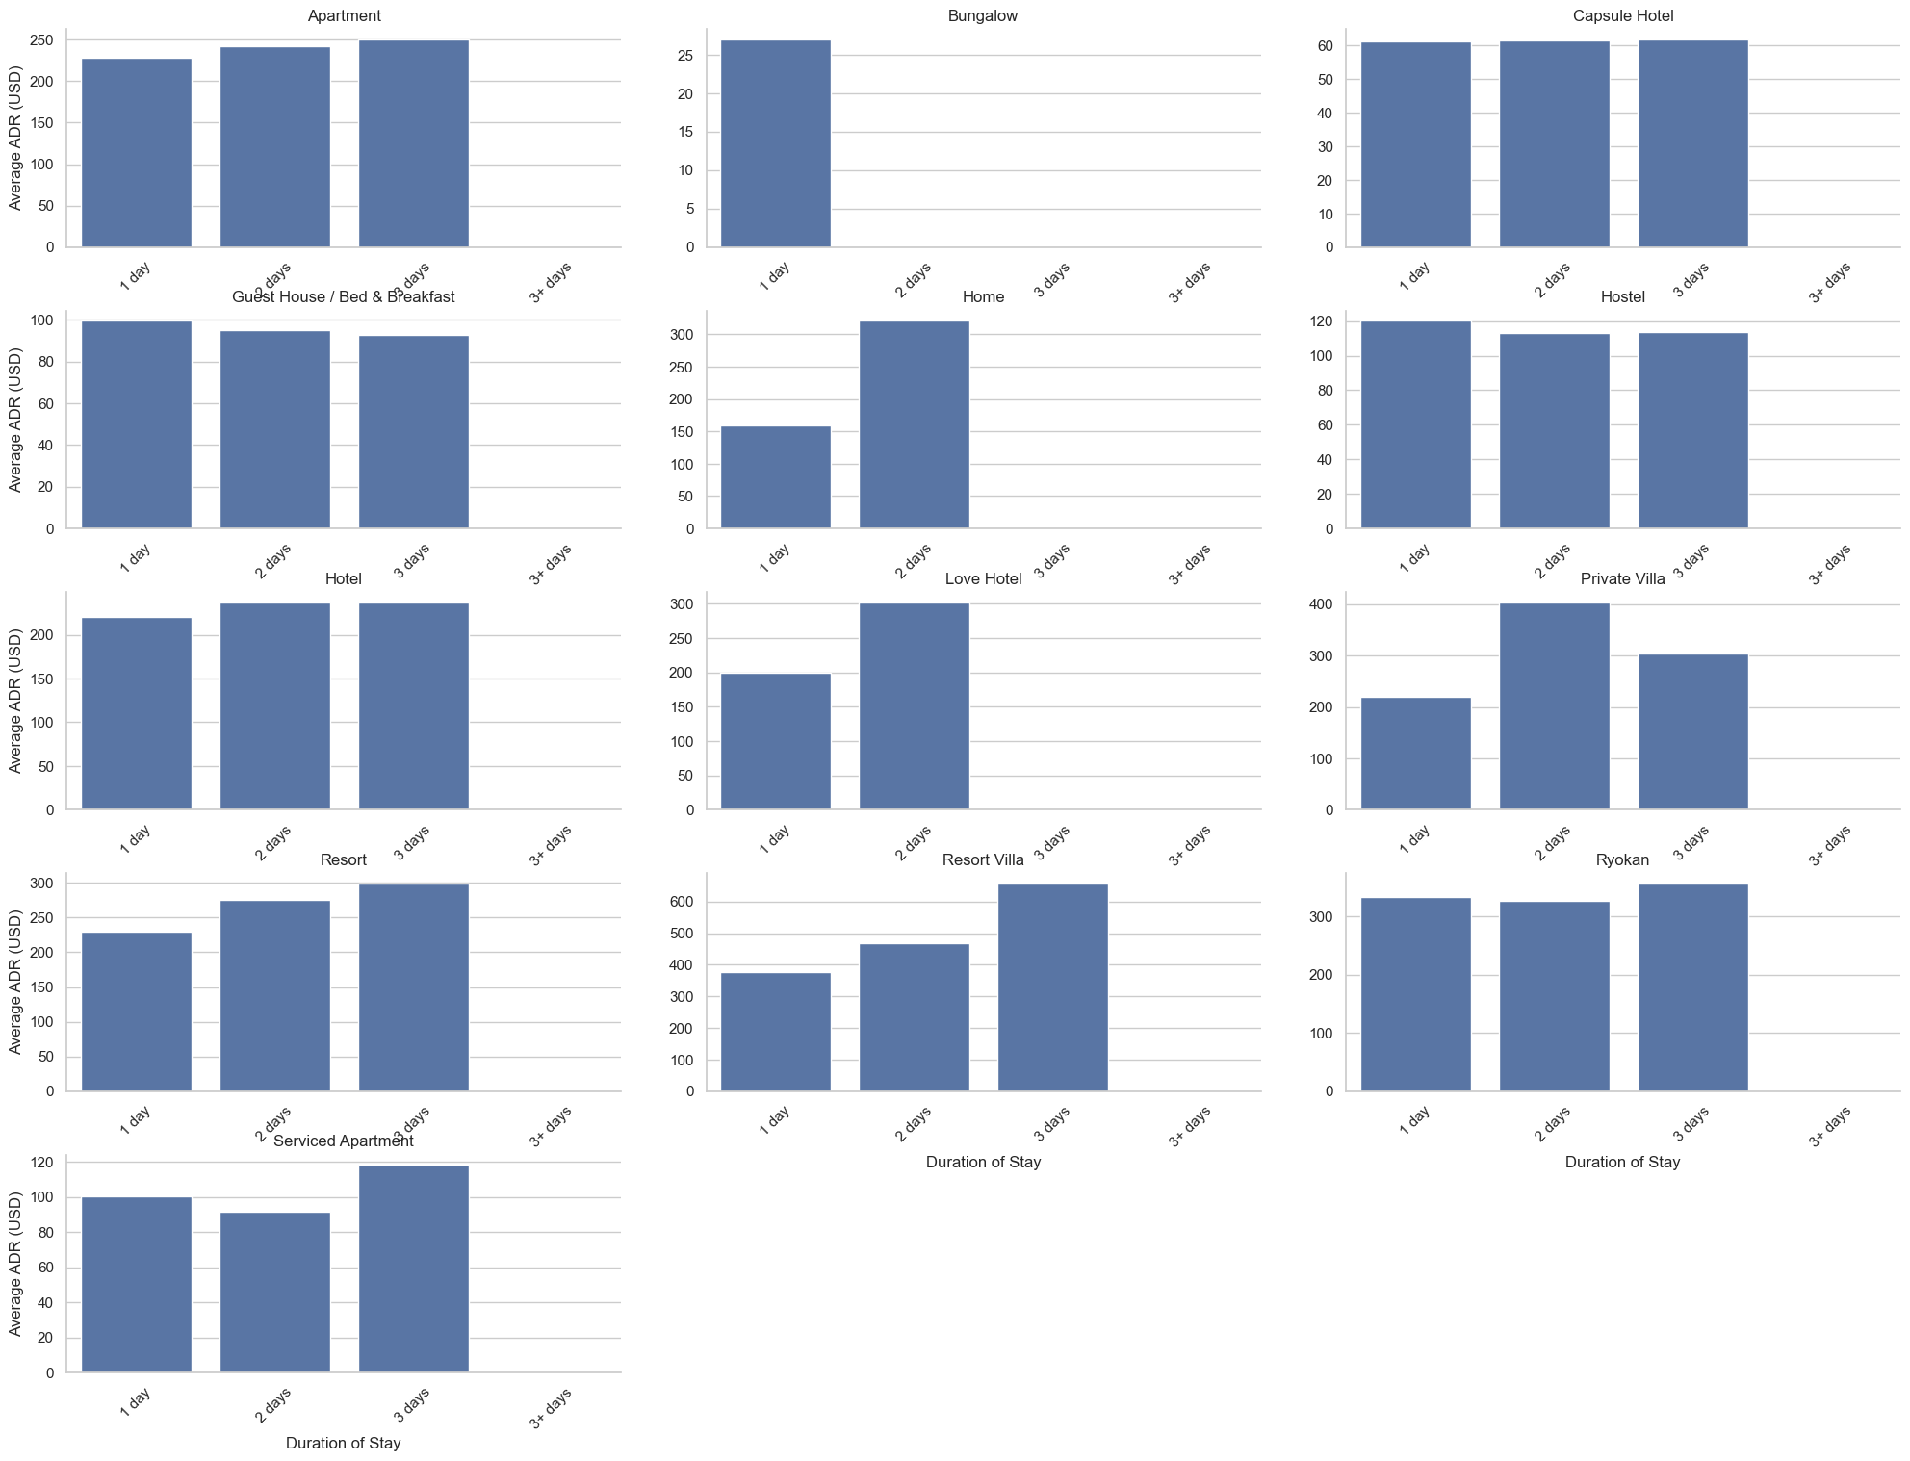
Some more Analysis:
ADR by Duration of Stay:
The series of bar charts represent the average daily rate (ADR) for various types of accommodations categorized by the duration of stay. The duration of stay is segmented into four buckets: 1 day, 2 days, 3 days, and 3+ days.
ADR analysis by stay duration reveals pricing optimization opportunities for extended stays

Slide 15
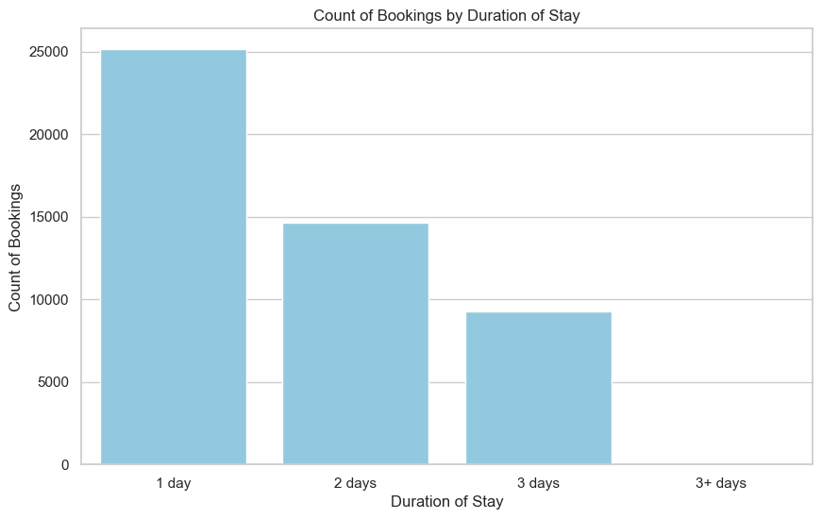
Some more Analysis:
Number of Bookings by Duration of Stay:
The image provided is a bar chart that illustrates the count of bookings categorized by the duration of stay. The durations are divided into four categories: 1 day, 2 days, 3 days, and 3+ days.
Prevalence of short-term bookings emphasizes potential for targeted promotions to encourage longer stays, optimizing occupancy and revenue.

Slide 16
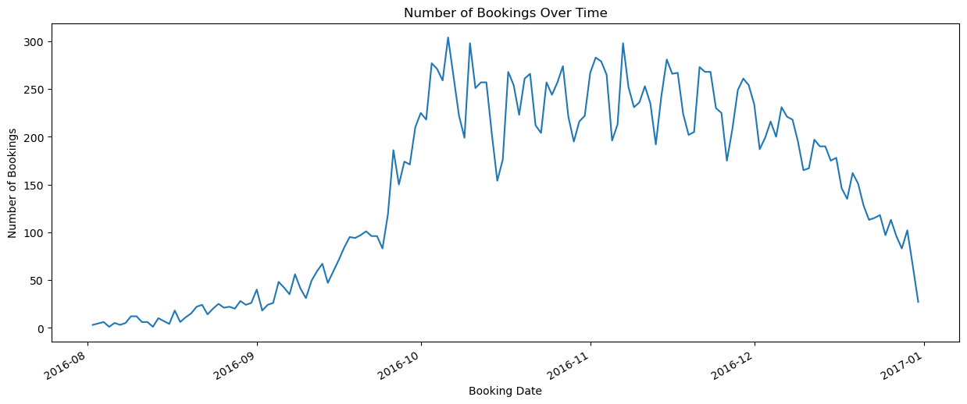
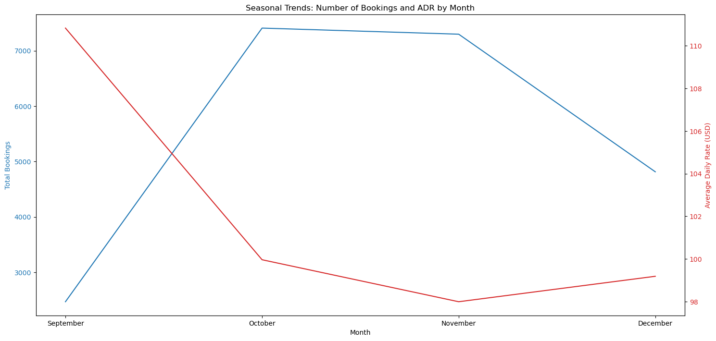

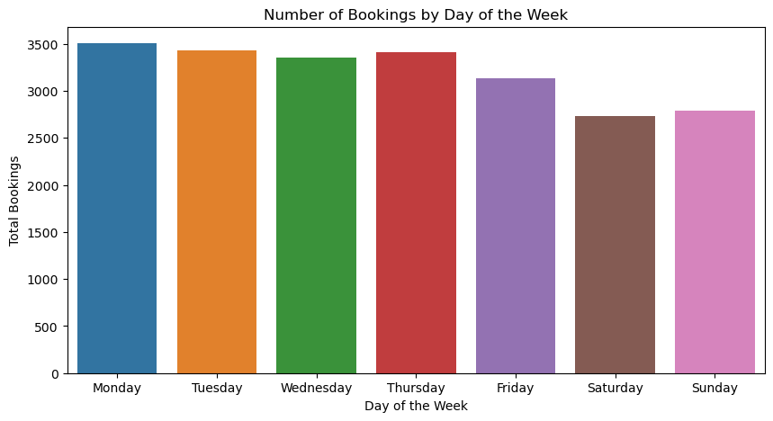
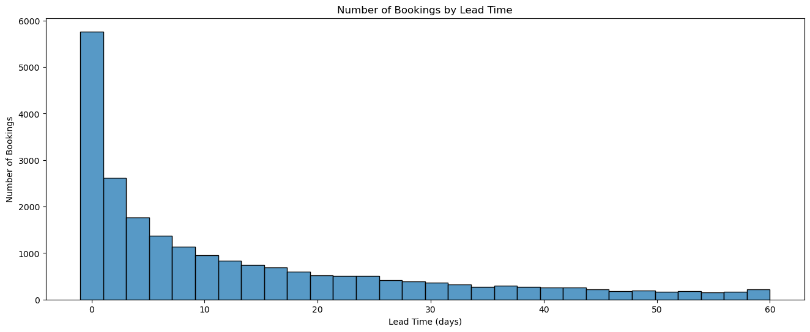
City specific Analysis

Slide 17
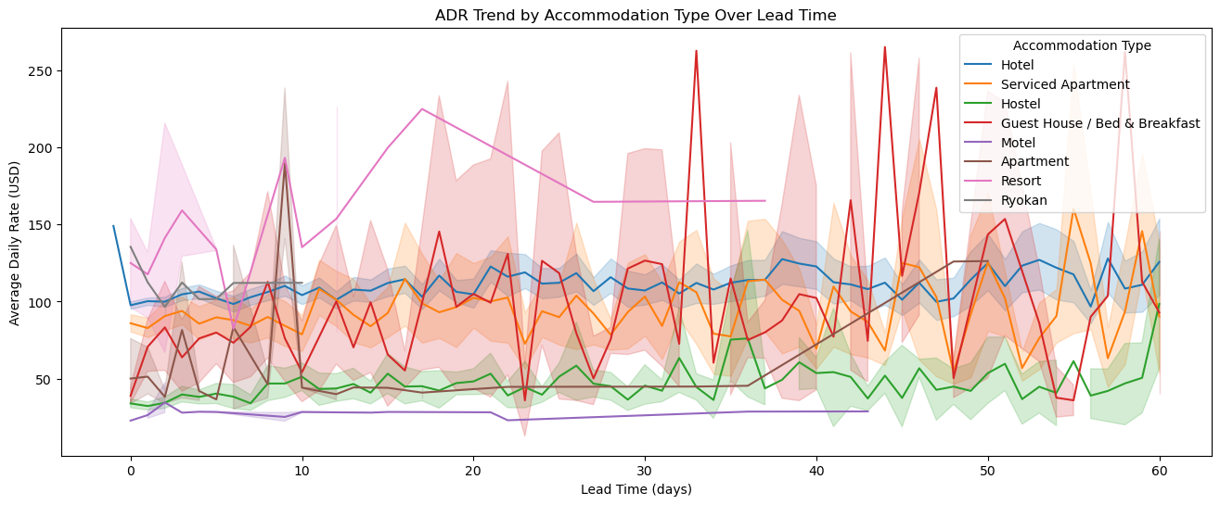
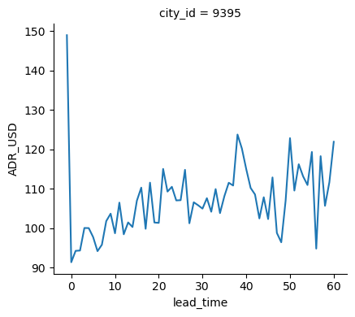
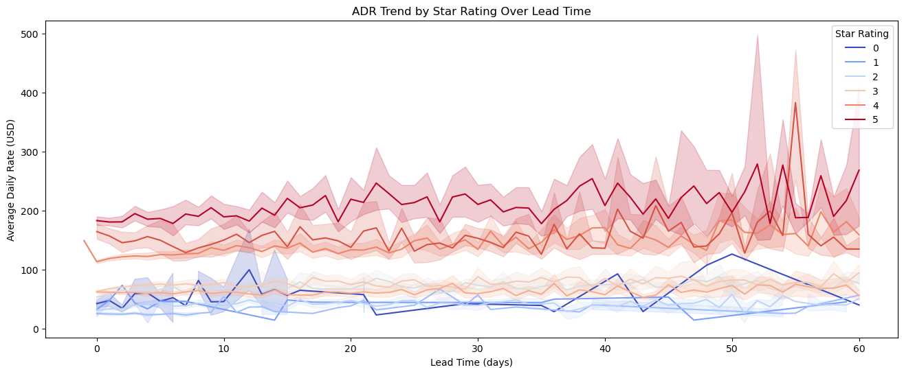
City specific Analysis

Slide 18
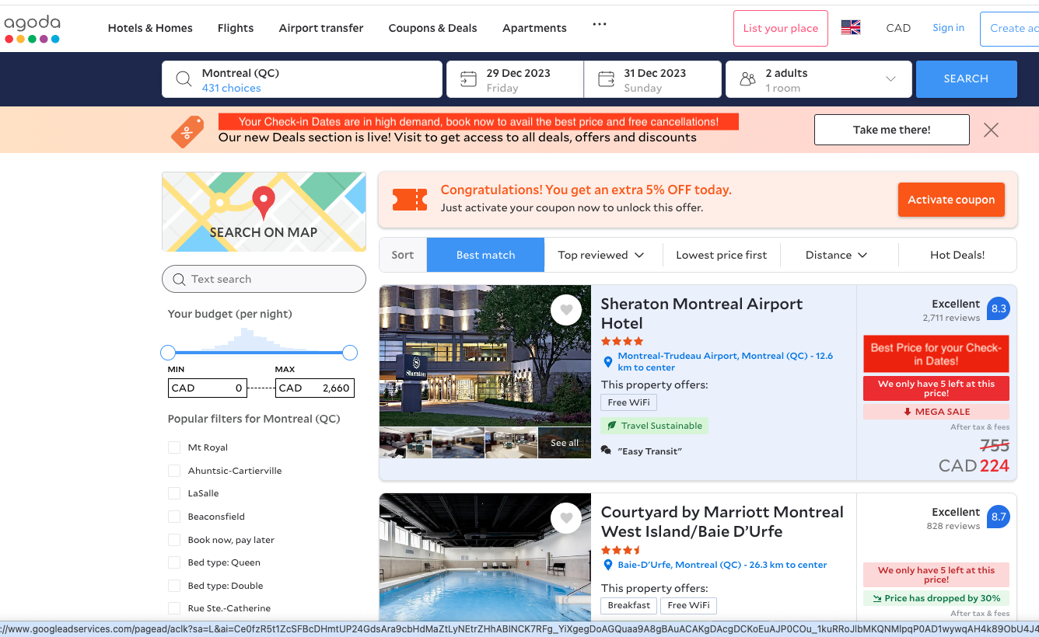
Strategy Implementation
Based on Data Analytics, best prices on selected check-in dates can be displayed on the Search result page.

Slide 19
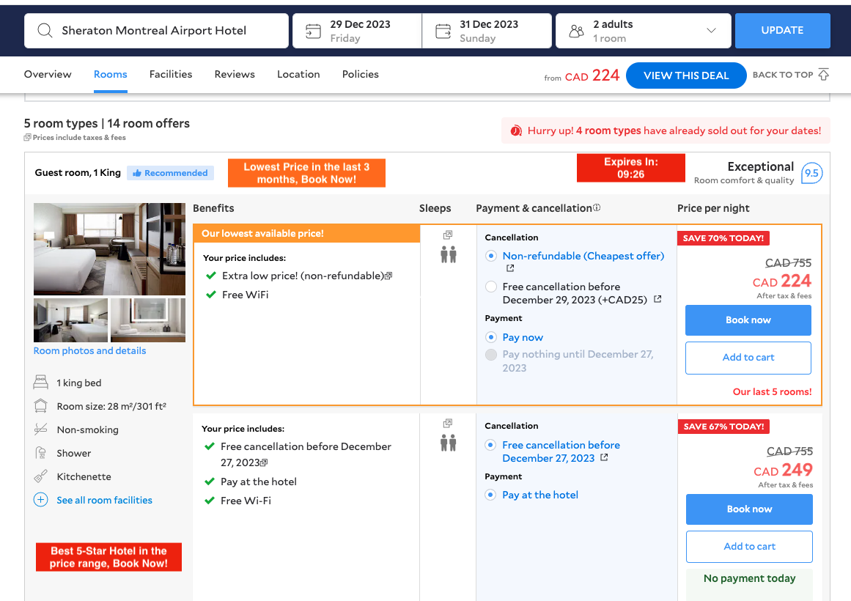
Strategy Implementation:
The property page can show urgency message based on the Star rating of the property. Time and Price-sensitivity tactics can also be implemented.

Slide 20
Future Recommendations:
Expand Data Collection: Incorporate customer demographic and behavior data to tailor promotions and urgency messaging more effectively.
Competitive Analysis: Benchmark against competitors to understand the market positioning and pricing strategies for various accommodation types.
Customer Sentiment: Customer Data, such as Booking History, wish-list items and Clicking patterns would help us to capture the customer sentiment.
Customer Feedback Integration: Leverage customer reviews and feedback to understand the drivers of booking choices, informing service and quality improvements.
Invest in Predictive Analytics: Employ Machine Learning algorithms to perform advanced analytics to predict future booking patterns and ADR trends, allowing for proactive strategy adjustments.
Post-Strategy Review: Detailed analysis after the implementations are necessary to measure the range of success in regard to new customer acquisition and increment in revenue.

Slide 21
Conclusion
Weekday-Weekend Dichotomy: Urgency Messages can direct customers to focus on weekend bookings.
Seasonal Sensitivity: Proactive pricing strategies during shoulder months can smooth occupancy rates and stabilize revenue.
Diverse Customer Behavior Dynamics: Our analysis has uncovered nuanced patterns across booking lead times, accommodation types, and seasonal trends, underpinning the complexity of traveler behavior.
Preferred Accommodation Spectrum: A strategic emphasis on ratings to maximize market share while exploring ways to uplift the perception and appeal of other categories is necessary.
Strategic Rate Management: The observed correlation between star ratings, ADR, and booking volume across lead times emphasizes the need for a differentiated rate management approach.
Periodic Data Review: Different iterations of strategy should be implemented to get the best result depending on changing factors.

Slide 22
Resources and References
Data Source: Main dataset is provided by Agoda.
Literary Resources on Marketing Analysis: Grandview Research and Think with Google insights into the online travel booking industry, service market size and growth rate, crucial for understanding the industry context.
Analytical Tools: SQL: For database management and query execution.
Python: Used for data manipulation and analysis.
Libraries:
Numpy: For numerical computations.
Pandas: For data manipulation and analysis.
Scikit-learn: For machine learning and predictive data analysis (Price Forcasting).
Insightful External Websites: MNI and Atlan provides insights into travel marketing trends, data analytics in the travel industry, and marketing strategies used in the travel industry
Further Reading and Industry Insights: To understand current trends and future predictions in the travel market, articles from Statista and insights from market research reports are valuable.

Slide 23
Questions?

Slide 24

THANK YOU!!

